Slide 1

NBA Draft Predictor
By: Naim Syed

Slide 2



Project Goal
NBA teams put significant investments into planning a draft strategy which directly impacts the long-term success of their franchise.
Who will be available when the team is making a selection?
Are teams going to pick the best player available, or will they pick a player who fills their needs?
How accurately can a machine learning model predict where a college basketball player will be drafted in the NBA Draft?

Slide 3
Project Plan
Step 1: Acquire Dataset
College basketball players between 2009 to 2021 (Advanced/Standard Stats)
Step 2: Exploratory Data Analysis and Feature Engineering
Step 3: Baseline Model Selection
Step 4: Model Tuning/Evaluation

Slide 4
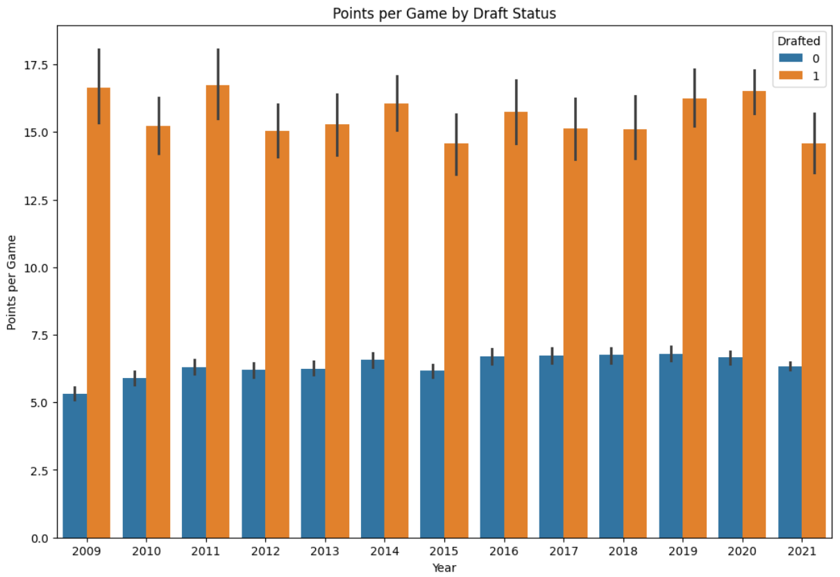
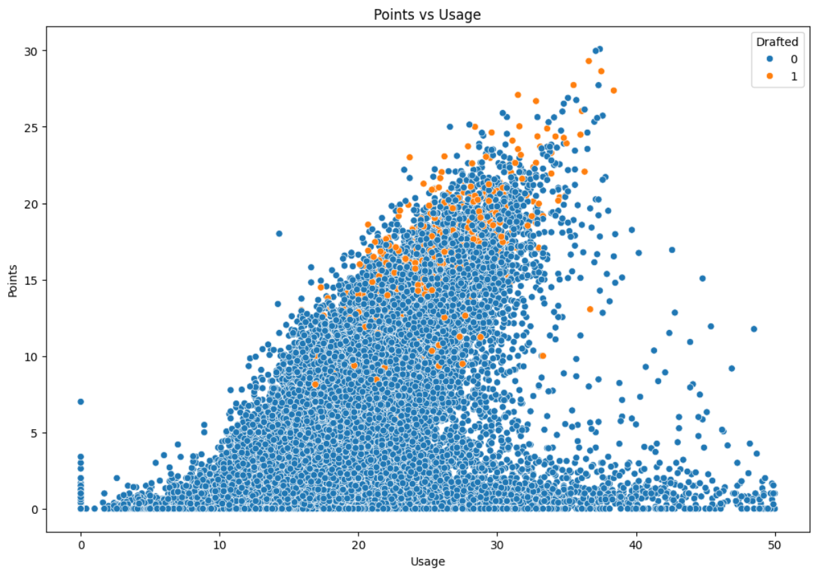
Exploratory Data Analysis

Slide 5
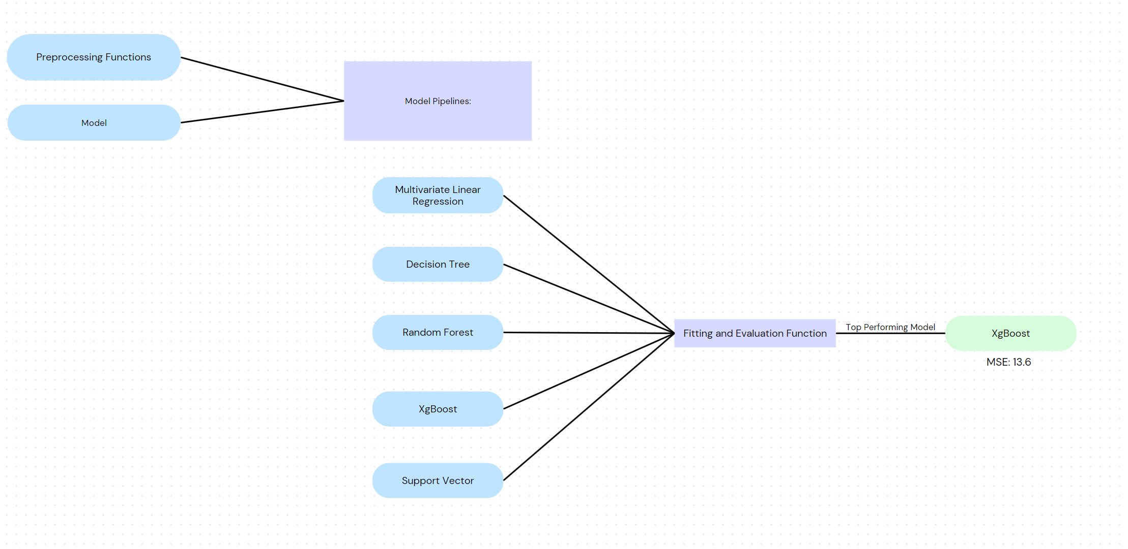
Baseline Model Selection

Slide 6
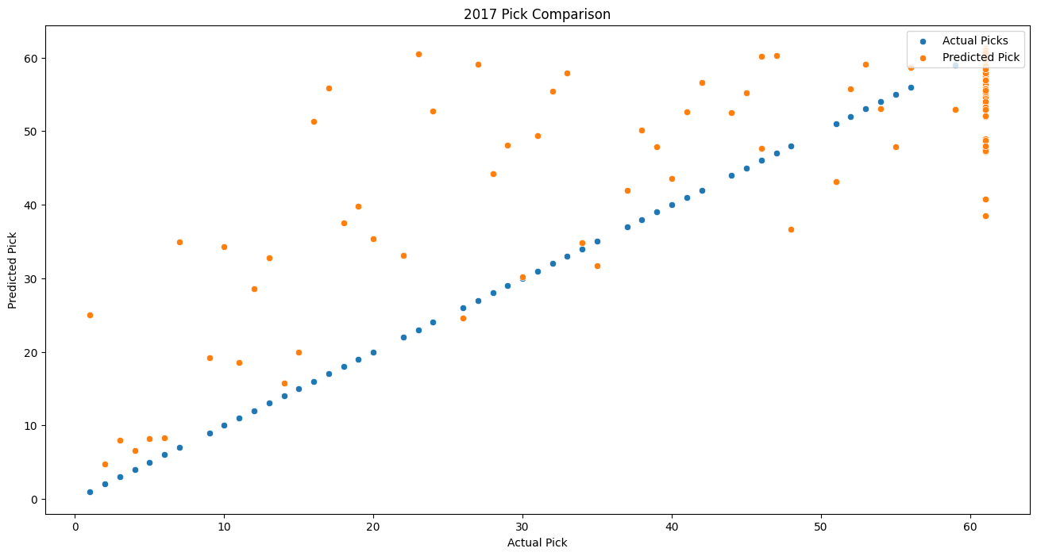
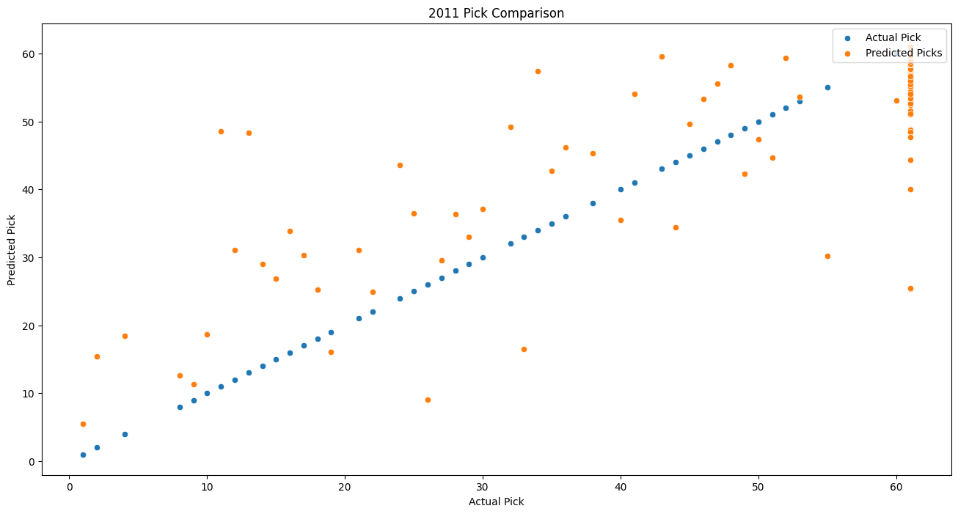
Model Tuning/Final Evaluation
Grid Search paired with kFold cross validation methods
Recommendation: Implement team specific data (i.e. current roster/needs)

